Slide 1
helium model
Lilu Ghoniashvili,Ana Jughashvili

Slide 2
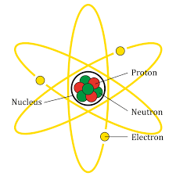
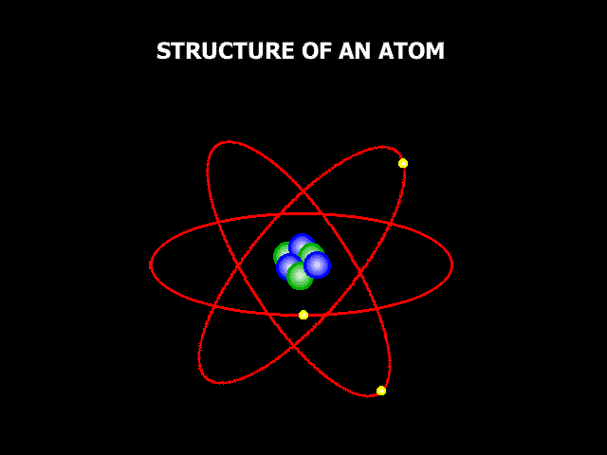
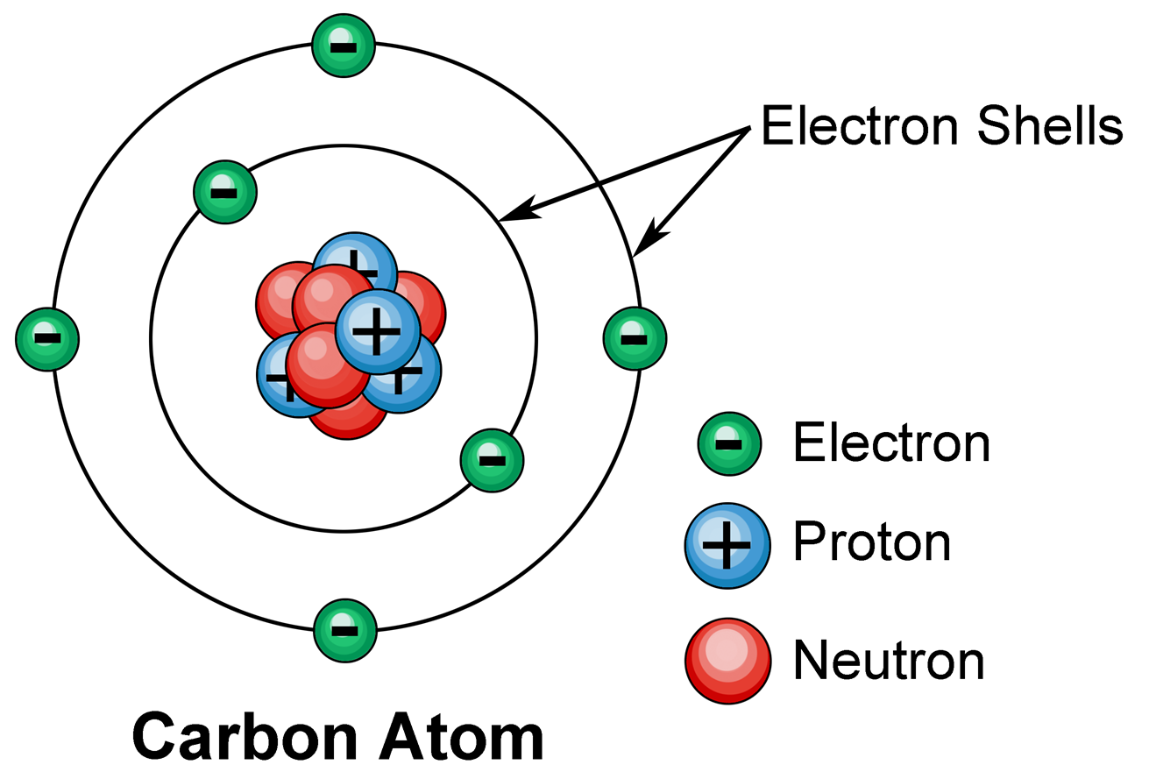
atom
The term "atom" comes from the Greek word for indivisible, because at the past, it was known as smallest object which could not be divided in smaller pieces
Protons
neutrons
electrons
quarks

Slide 3

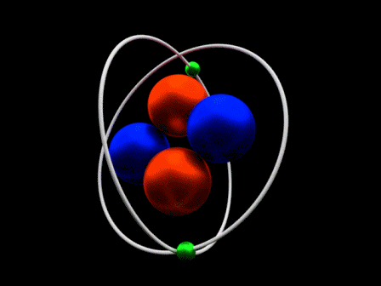
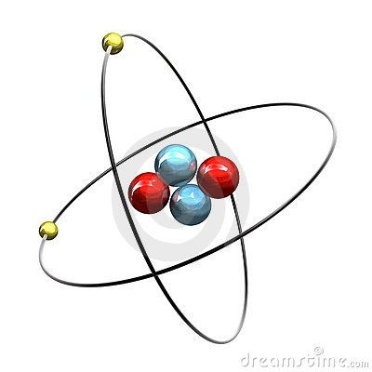
helium
Helium is known as colorless gas
Helium contains nucleus where two electrons are bound by the electromagnetic force.
leak detector

Slide 4
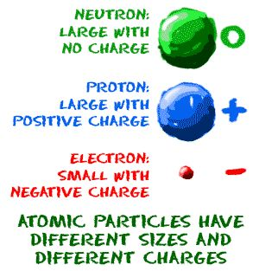
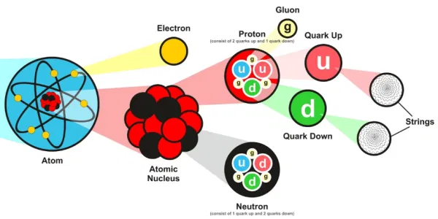
Atom sizes
R electron- 10^-18
R proton- 5*10^-16
R neutron-5*10^-16
D between el. and pro.-5.3*10^-11
D between protons- D=2R (10^-15)

Slide 5
scale dimensions
*10^18
The radius of the electron (1)
The radius of proton (5*10^2)
The radius of the neutron (5*10^2)
The distance between el. and pro. (5.3*10^7)
Distance between protons (10^3)
In model
The radius of the electron (1cm)
The radius of proton (2.5cm)
The radius of the neutron (2.5cm)
The distance between el. and pro. (10.6cm)
Distance between protons (5cm)
diameter of hole atom is (36.2) (10.6*2+5*2+5=36.2)

Slide 6
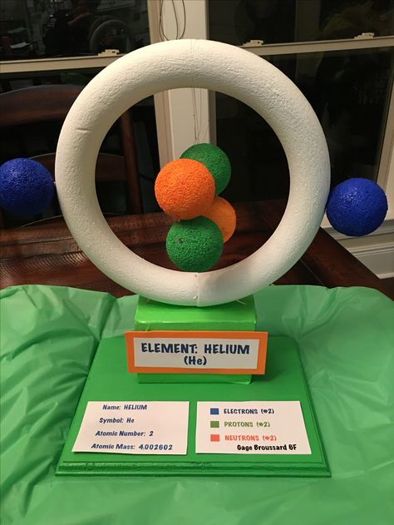
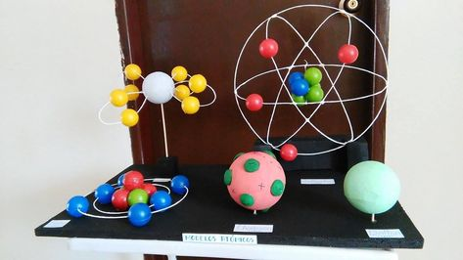
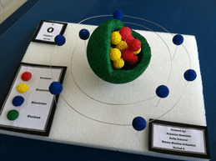
Incurrence
Size of atoms
Information
Incurrence measurement

Slide 7
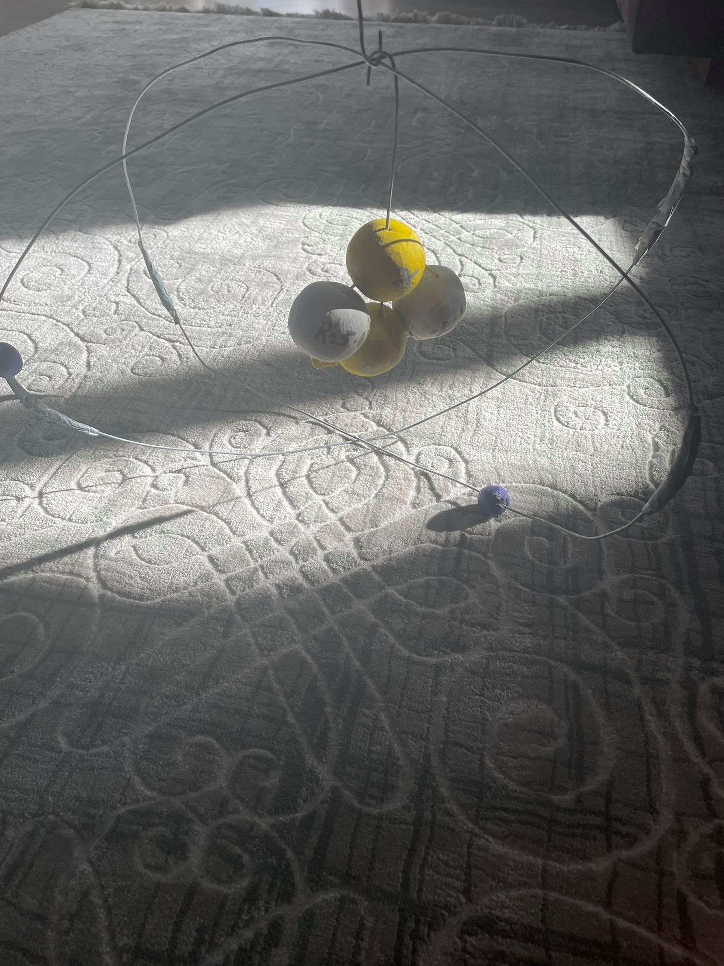
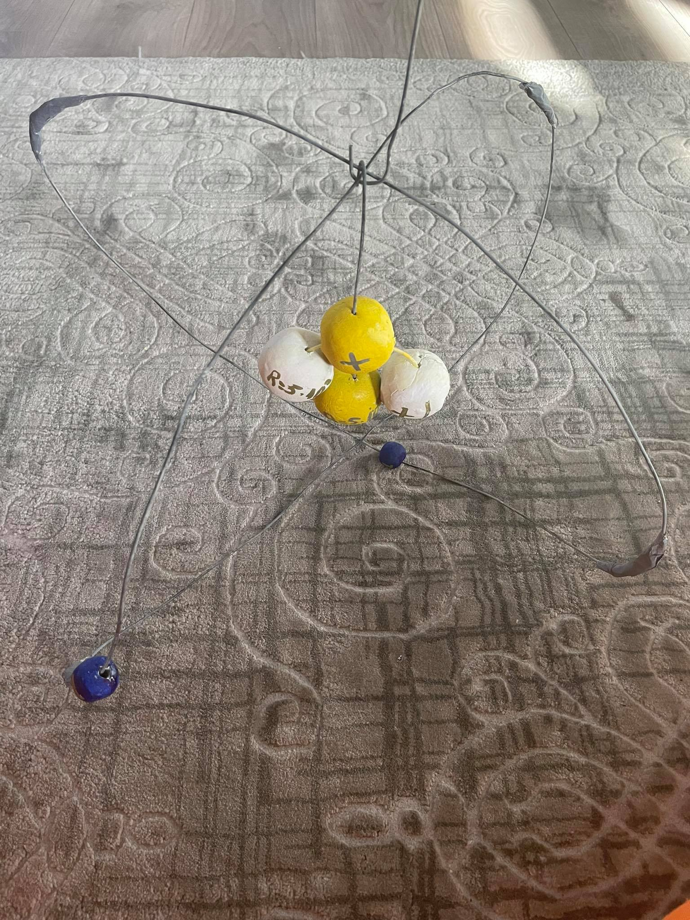


Our model

Slide 8

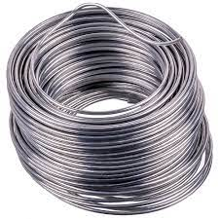

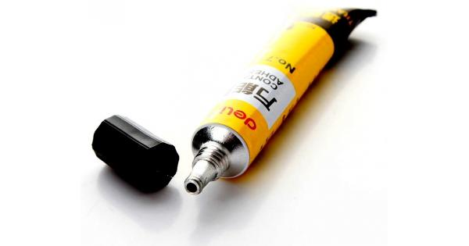
materials
Wire
clay
glue
paint

Slide 9

Sources
electrons
https://www.researchgate.net/post/What-is-the-closest-experimental-value-we-have-for-the-radius-of-the-free-electron
https://en.wikipedia.org/wiki/Electron
protons and neutrons
https://hypertextbook.com/facts/1999/YelenaMeskina.shtml
distance between protons and electrons
https://www.quora.com/What-is-in-the-space-between-a-proton-and-an-electron

Slide 10


